Slide 1
Orthopedic Devices
Dr. Mehdi Rezaei
Assistant Professor, Department of Orthopaedic Surgery, TUMS

Slide 2
Outlines
Anatomy
Terminology
Osteology
Biomechanics
Orthopedic devices

Slide 3
Approaches to Studying Anatomy
Anatomy: study of the structure of the human body
Regional anatomy
Systemic anatomy
Surface anatomy
Radiographic anatomy
Clinical anatomy

Slide 4
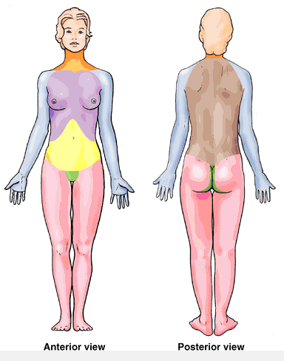
Regional Anatomy
Head
Neck
Trunk
Thorax
Abdomen
Back
Pelvis/perineum
Paired upper limbs and lower limbs
Head
Neck
Thorax
Back
Abdomen
Upper Limb
Pelvis/Perineum
Lower Limb

Slide 5
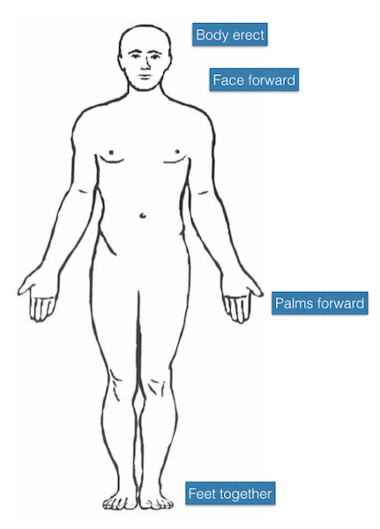
Anatomical Position
Head, gaze (eyes), and toes directed anteriorly (forward).
Arms adjacent to the sides with the palms facing anteriorly.
Lower limbs close together with the feet parallel and the toes directed anteriorly.

Slide 6
Anatomical Planes
The median plane divides the body into right and left halves

Slide 7
Anatomical Planes
Sagittal planes vertical planes parallel to the median plane

Slide 8
Anatomical Planes
Frontal (coronal) planes divides the body into anterior (front) and posterior (back) parts

Slide 9
Anatomical Planes
Transverse planes
divides the body into superior (upper) and inferior (lower) parts.
Transaxial/axial planes

Slide 10
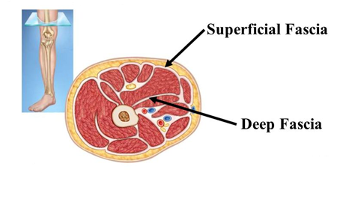
Terms of Relationship and Comparison
Superficial: Toward the surface
Intermediate: Between a Superficial and Deep structure
Deep: Away from the surface of the body

Slide 11
Terms of Relationship and Comparison
Posterior (dorsal): nearer to the back.
Anterior (ventral): nearer to front surface of the body.

Slide 12
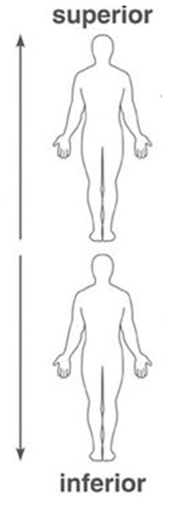
Terms of Relationship and Comparison
Inferior: structure nearer the sole of the foot
Superior: structure nearer the skull

Slide 13
Terms of Relationship and Comparison
Proximal : Nearer to trunk or point of origin
Distal: Farther from trunk or point of origin

Slide 14
Terms of Relationship and Comparison
Medial: nearer to the median plane of the body than the other digits
Lateral: farther away from the median plane

Slide 15
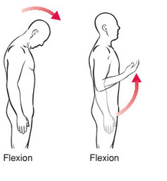
Terms of Movement
Flexion: bending or decreasing the angle between the bones or parts of the body.
knee joint : posterior movement.

Slide 16
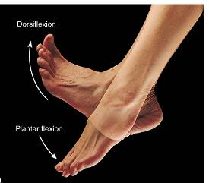
Terms of Movement
Dorsiflexion
Plantar flexion

Slide 17
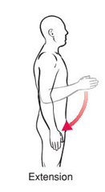
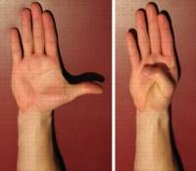
Terms of Movement
Extension: straightening or increasing the angle between the bones or parts of the body.
knee joint: in an anterior direction.

Slide 18
Terms of Movement
Abduction : moving away from the median plane in the frontal plane
abduction of the digits: spreading them apart

Slide 19
Terms of Movement
Adduction: moving toward the median plane in a frontal plane
adduction of the digits: reapproximating the spread fingers or toes

Slide 20
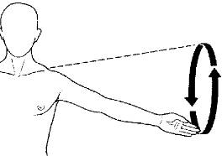
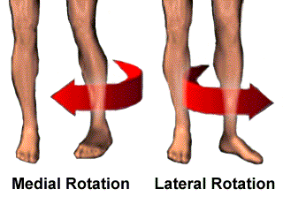
Terms of Movement
Circumduction:
combination of flexion, extension, abduction, and adduction
Medial rotation (internal rotation) brings the anterior surface of a limb closer to the median plane
Lateral rotation (external rotation) takes the anterior surface away from the median plane.

Slide 21
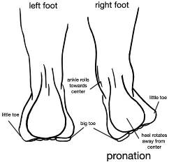
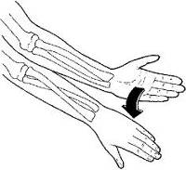
Terms of Movement
Pronation rotational movement of the forearm and hand that swings the radius medially around its longitudinal axis

Slide 22
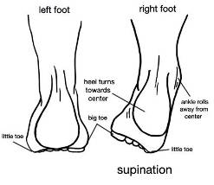
Terms of Movement
Supination rotational movement of the forearm and hand that swings the radius laterally around its longitudinal axis

Slide 23
Terms of Movement
Inversion moves the sole of the foot toward the median plane
When the foot is fully inverted it is also plantar-flexed.
Eversion moves the sole of the foot away from the median plane
When the foot is fully everted it is also dorsiflexed
Eversion

Slide 24
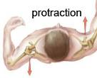
Terms of Movement
Opposition movement by which the pad of the 1st digit is brought to another digit pad
Reposition movement of the 1st digit from the position of opposition back to its anatomical position
Protrusion movement anteriorly (forward)
Retrusion movement posteriorly (backward),

Slide 25
Terms of Movement
Elevation raises or moves a part superiorly
Depression lowers or moves a part inferiorly

Slide 26
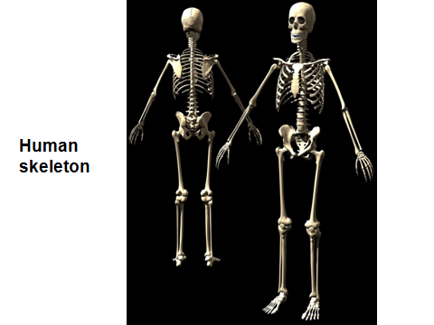

Slide 27
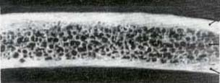
General structures of bone
compact bone
spongy bone

Slide 28
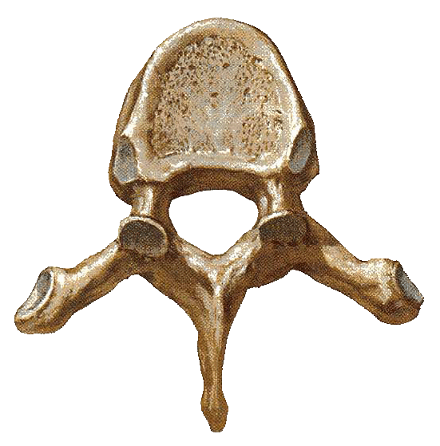
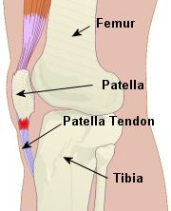
Classification
Long bones
Short bones
Flat bone
Irregular bones
Sesamoid bone
Pneumatic bones

Slide 29
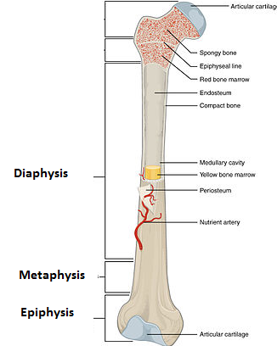
Long Bone
Diaphysis- has a thick outer compact bone
Metaphysis- a thin part of diaphysis adjoning epiphysis
Epiphysis- proximal and distal rounded part

Slide 30
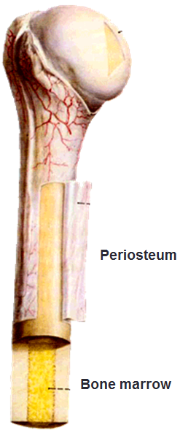
General structures of bone
Periosteum
Outer layer
Inner layer
Endosteum
a single-cellular osteogenic layer lining the inner surface of bone.
Bone marrow
Red marrow haematopoietic center
Yellow marrow: fat

Slide 31
Terms used in osteology
Bone surface structures
Elevations
Facets
Head and Condyle
Depressions
Foramen

Slide 32
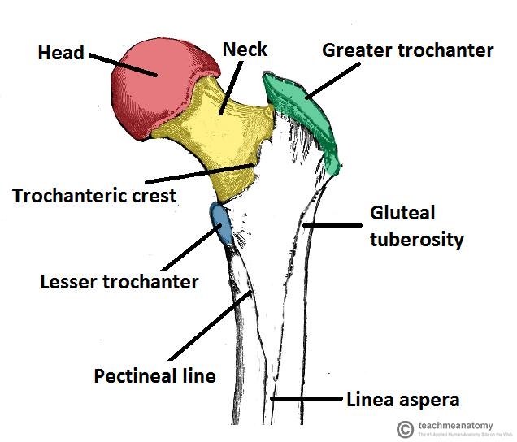
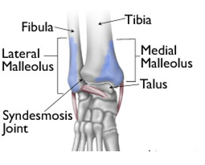
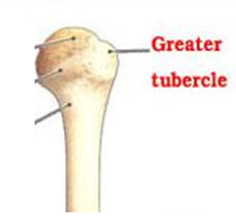
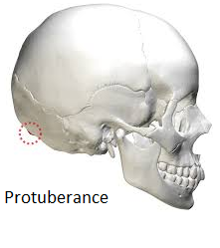
Elevations
Linear elevations
Lines/ridges
Crest
Rounded elevations
-Tubercle
-Protuberance
-Tuberosity
-Malleolus-
-Trochanter-

Slide 33
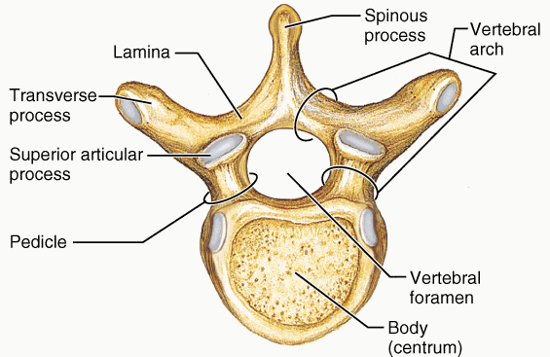
Elevations
Sharp elevation
-Spinous process
-Clinoid process

Slide 34
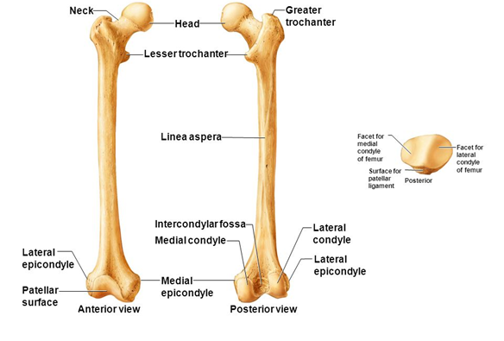
Facet: Small, smooth, flat articular surface
Head and Condyle: Rounded articular surface normally covered by cartilage e.g head of humerus, condyles of femur
Epicondyle--prominent process just above a condyle

Slide 35
Depressions
Sulcus: Shallow and long depression on the bone surface.
Fossa: Deep depressions on the bone surface
Notch or Incisura: Semicircular depressions
Foramen-Openings or holes
Canal- A long foramen
Meatus- canal that enter the bone but does not go through it

Slide 36
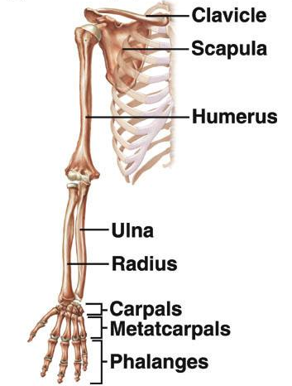
Skeleton of the Upper Limb
Each upper limb has 32 bones
Two separate regions
1. The pectoral (shoulder) girdle (2 bones)
2. The free part (30 bones)

Slide 37
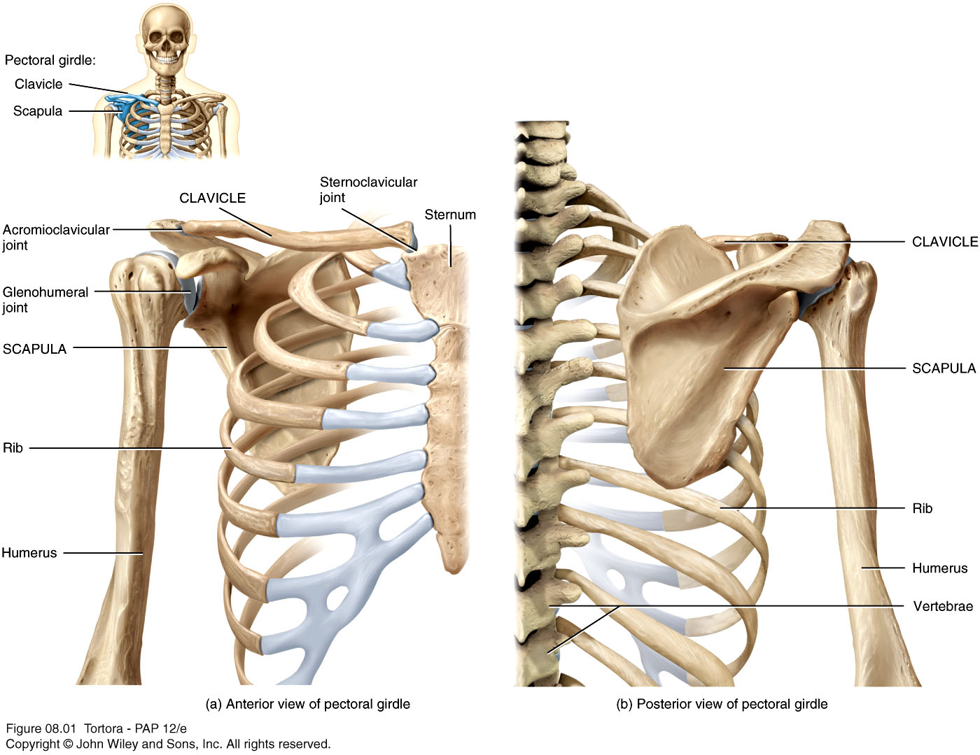
The Pectoral (or Shoulder) Girdle

Slide 38
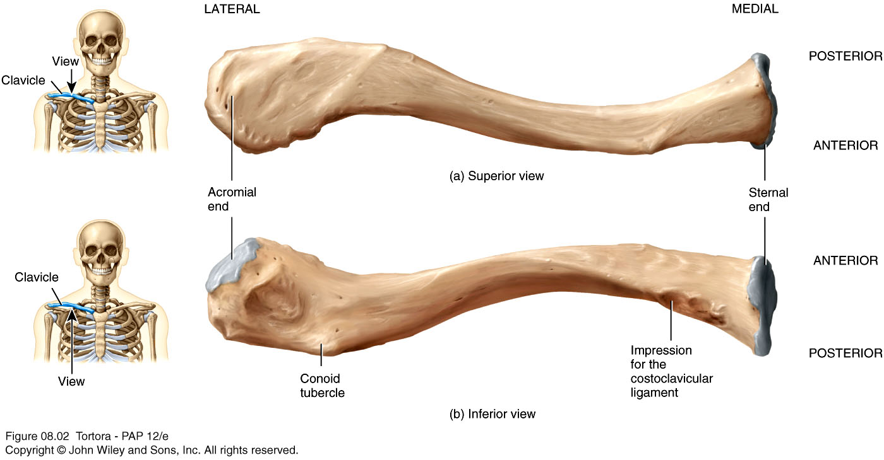
The Clavicle

Slide 39
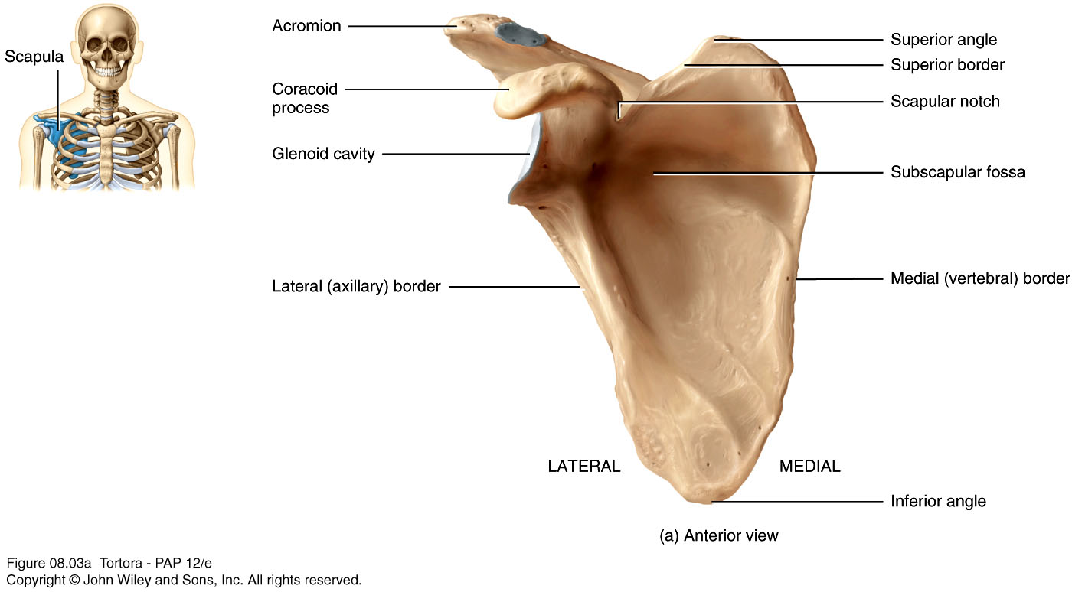
Scapula

Slide 40
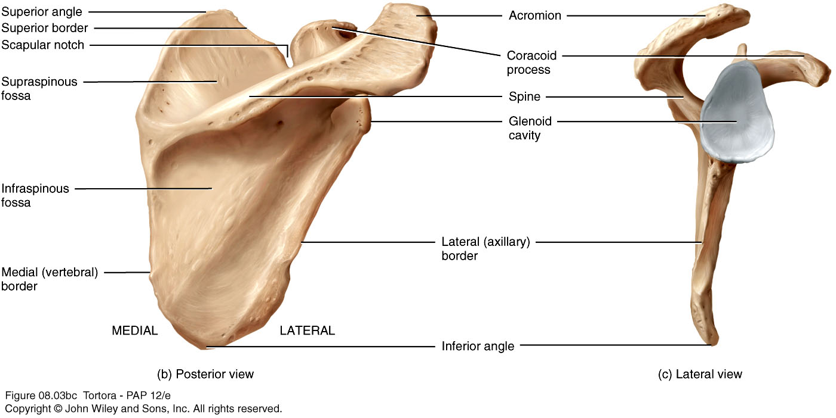
Scapula

Slide 41
Upper Limb
The free part has 30 bones
1 humerus (arm)
1 ulna (forearm)
1 radius (forearm)
8 carpals (wrist)
19 metacarpal and phalanges (hand)
Notes:
While progressing through a lecture, point out that many of the bones and their surface features (e.g., olecranon) may be easily palpated.

Slide 42
Skeleton of the Arm - Humerus
Longest and largest bone of the free part of the upper limb
The proximal ball-shaped end articulates with the glenoid cavity of the scapula
The distal end articulates at the elbow with the radius and ulna

Slide 43
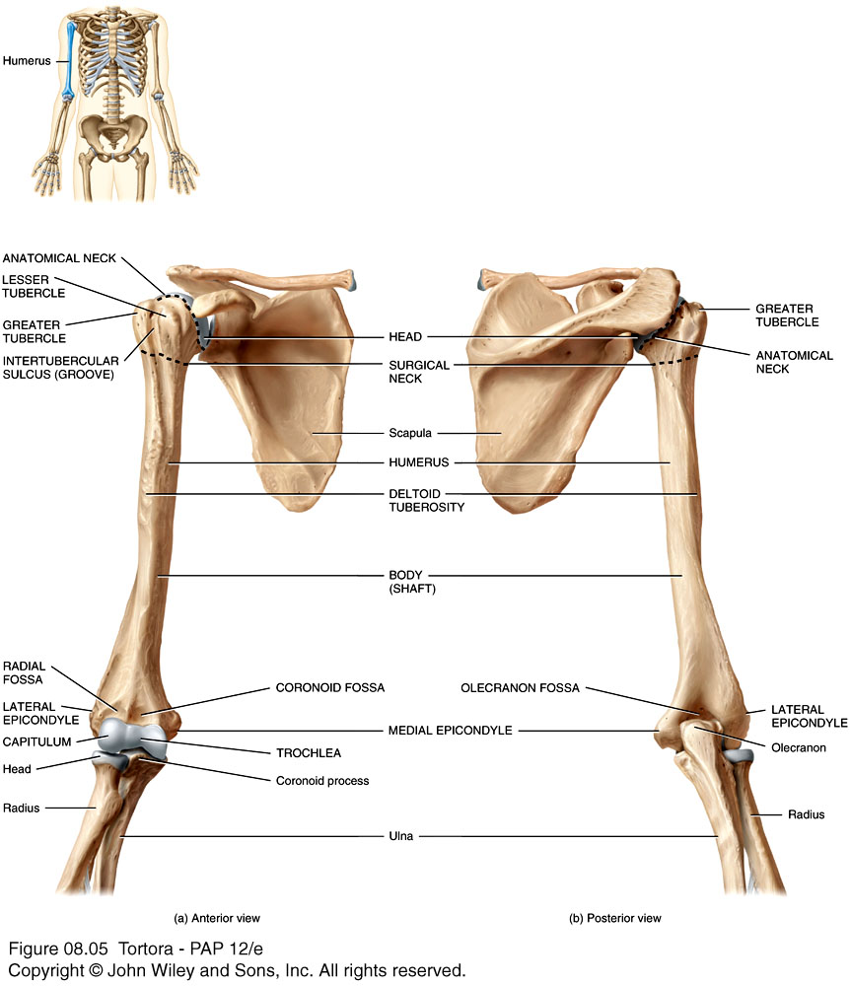

Slide 44
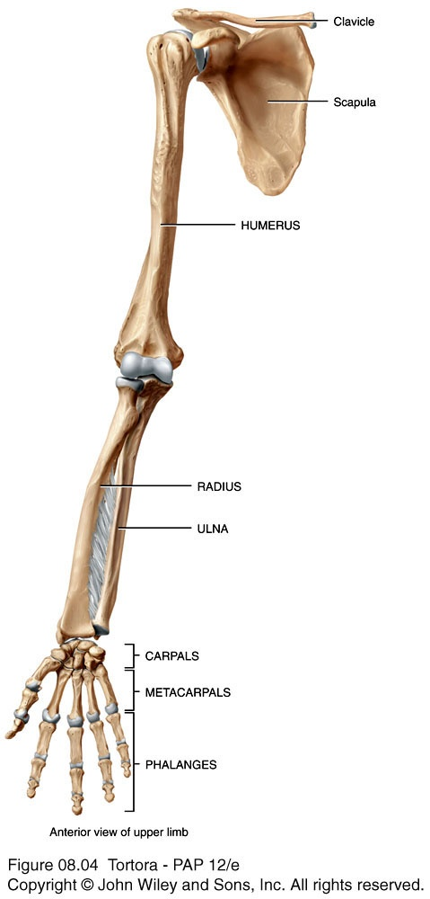
Humerus and Glenohumeral Joint

Slide 45
Skeleton of the Forearm - Ulna
The longer of the two forearm bones
Located medial to the radius
Olecranon - the large, prominent proximal end, the “tip of your elbow”
Coronoid process - the anterior “lip” of the proximal ulna
Trochlear notch - the deep fossa that receives the trochlea of the humerus during elbow flexion
Styloid process - the thin cylindrical projection on the posterior side of the ulna’s head

Slide 47
Right humerus in relation to scapula, ulna, and radius

Slide 48
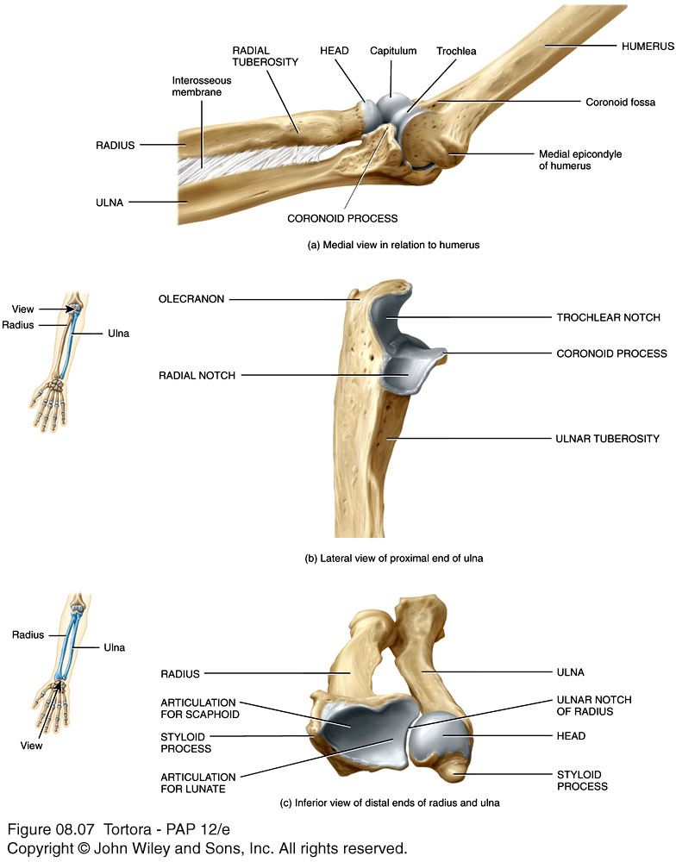
Articulations formed by the ulna and radius

Slide 49
Radius
Lies lateral to the ulna (thumb side of the forearm)
The head (disc-shaped) and neck are at the proximal end
The head articulates with the capitulum of the humerus and the radial notch of the ulna
Radial tuberosity - medial and inferior to neck, attachment site for biceps brachii muscle
Styloid process - large distal projection on lateral side of radius

Slide 50
Ulna and Radius
The shaft of these bones are connected by an interosseus membrane
There is a proximal radioulnar joint and a distal radioulnar joint
Proximally, the head of the radius articulates with the radial notch of the ulna
Distally, the head of the ulna articulates with the ulnar notch of the radius

